Slide 1
IMDB Text Data Exploration & Visualizations
Sergio Robledo
05/09/2019

Slide 2
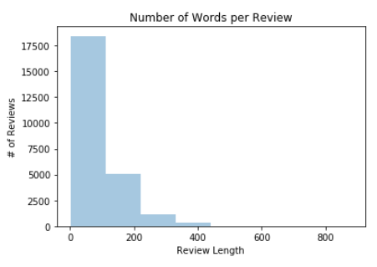
Review Lengths
Out of 25,000 reviews
Average review length is about 94 words
More than half of reviews are 71 or less words in length
Only 14 reviews longer than 500 words
Before Preprocessing
Average Review Length of 233 Words
Vocabulary Size of 280,617 Unique Words
Before preprocessing
Average Review Length of About 94 Words
Vocabulary Size of 6,690 Unique Words

Slide 3
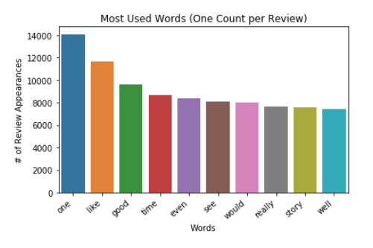
ALL REVIEWS: Word Counts
Top words provide some sentiment
“good” has positive connotation, or sentiment
More context is still needed for top words
”really” could mean “really good” or “really bad”
How to account for context when training
Kera’s embedding layer
Takes in words replaced by integers
Each integer represents a word

Slide 4
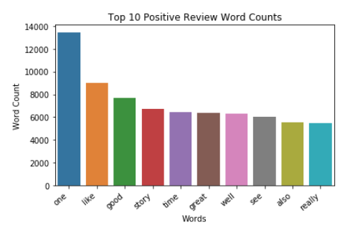
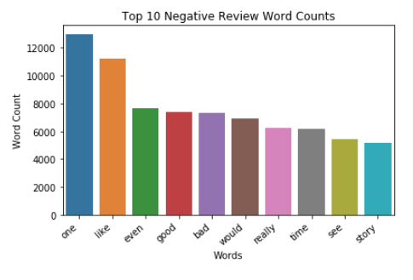
Positive and Negative Word counts
Positive Reviews: 12,500
Average review length about 95 words in length
Half of reviews 71 or less words in length
Negative Reviews: 12,500
Average review length about 94 words in length
Half of reviews 72 or less words in length
Most common words shared by positive and negative reviews
Words in positive top 10 but not in negative top 10
“also”, “great”, ”well”
Words in negative top 10 but not in positive top 10
“even”, “bad”, “would”

Slide 5
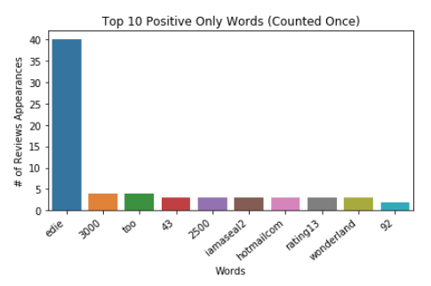
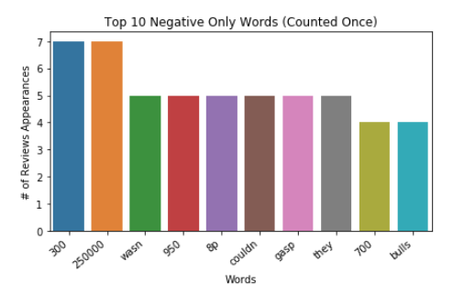
Exclusive Review Counts
Words exclusive to either positive or negative reviews
Not found in both datasets
Only one word count per review
Repeated words in a review ignored
Little sentiment information contained
Supports previous belief: context matters
Word “edie” used frequently in only positive reviews
Next Question?
Why “edie”?

Slide 6
Why “edie”?
Of the reviews containing “edie”, many contained “big edie little edie”
Researched instances of “big edie little edie” on the web
Reviews correspond to movie Grey Gardens released in 1975
Highly rated movie, which explains why only positive reviews include “edie”
Leave it in training data in case future test review containing “edie”

Slide 7
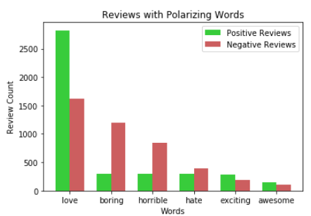
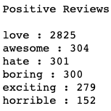
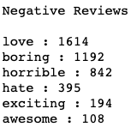
Polarizing Word Counts
Comparison of polarizing, or words rich in sentiment
Each word counted only once per review
Avoids highly repetitive reviews
Positive reviews have more positive words
For example, “love” appears almost 2x more often in positive than in negative reviews
Negative reviews have more negative words
For example, ”boring” is about 4x more likely to appear in a negative review than a positive one
Statistically Significant?
Next we are going to conduct inferential statistic tests to check validity of observations

Slide 8
“Love” Statistically Significant?
Observed reviews containing “love”
Positive: 2,825 out of 12,500
Negative: 1,614 out of 12,500
Difference: 1,211 Reviews
How to test?
Hypothesis: difference due to chance
Method used: permutation replicates
100,000 permutation replicates
Metric: review count differences
Guarantees equal probability
“love” being in positive and negative reviews
Results: Probability of Difference >= 1,211
Zero replicates out of 100,000
99%+ replicates had a difference of 155 or less
Almost 100% certainty difference observed is not due to chance
Review containing “love” has higher probability of being positive

Slide 9
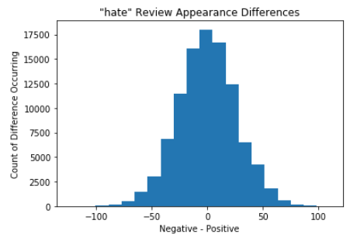
“hate” permutation Replicates
Observed reviews containing “hate”
Positive: 301 out of 12,500
Negative: 395 out of 12,500
Difference: 94 Reviews
How to test?
Same procedure done for “love”
Results: Probability of Difference >= 94
16 replicates out of 100,000
99%+ replicates had a difference of 68 or less
More than 99.9% certainty difference observed is not due to chance
Review containing “hate” is more likely to be a negative review
Conclusion: stand-alone words will be useful for classifier
Context of words still needed for better model performance

